Slide 1

ODC
Beyond The Data Grid: Coherence, Normalisation, Joins and Linear Scalability
Ben Stopford : RBS

Slide 2
The Story…
Industry and academia have responded with a variety of solutions that leverage distribution, use of a simpler contract and RAM storage.
We introduce ODC a NoSQL store with a unique mechanism for efficiently managing normalised data.
The internet era has moved us away from traditional database architecture, now a quarter of a century old.
We show how we adapt the concept of a Snowflake Schema to aid the application of replication and partitioning and avoid problems with distributed joins.
The result is a highly scalable, in-memory data store that can support both millisecond queries and high bandwidth exports over a normalised object model.
Finally we introduce the ‘Connected Replication’ pattern as mechanism for making the star schema practical for in memory architectures.

Slide 3
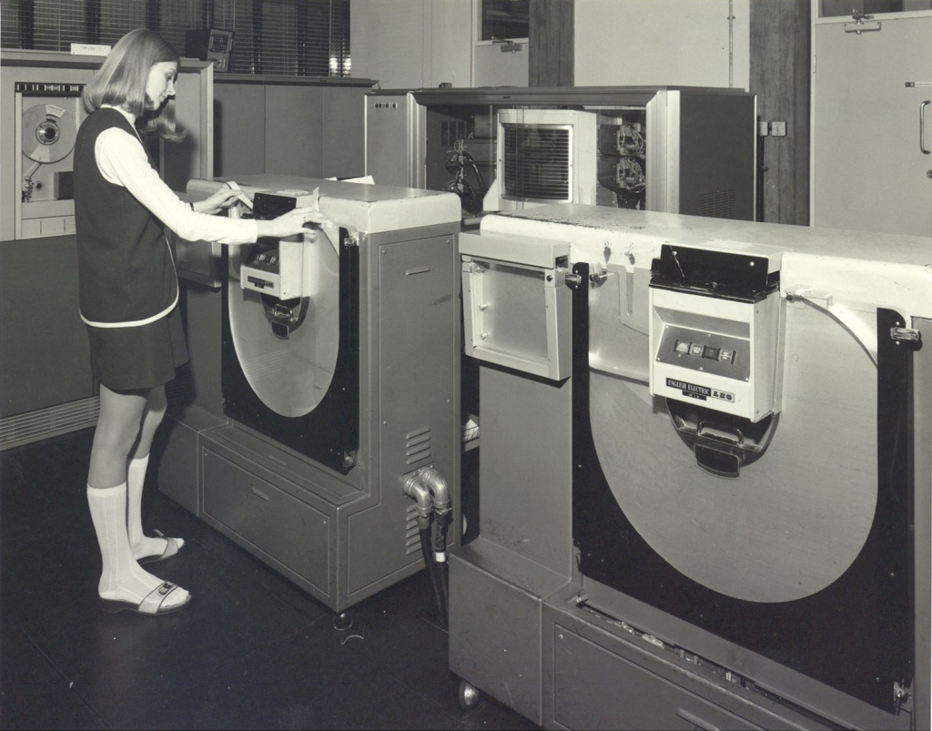
Database Architecture is Old
Most modern databases still follow a 1970s architecture (for example IBM’s System R)

Slide 4
“Because RDBMSs can be beaten by more than an order of magnitude on the standard OLTP benchmark, then there is no market where they are competitive. As such, they should be considered as legacy technology more than a quarter of a century in age, for which a complete redesign and re-architecting is the appropriate next step.”
Michael Stonebraker (Creator of Ingres and Postgres)

Slide 5
What steps have we taken to improve the performance of this original architecture?

Slide 6



Improving Database Performance (1) Shared Disk Architecture
Shared
Disk

Slide 7
Improving Database Performance (2) Shared Nothing Architecture
Shared Nothing

Slide 8
Improving Database Performance (3) In Memory Databases

Slide 9
Improving Database Performance (4) Distributed In Memory (Shared Nothing)

Slide 10
Improving Database Performance (5) Distributed Caching
Distributed Cache

Slide 11
These approaches are converging
Shared
Nothing
Drop Disk
Scale out
Shared
Nothing
(memory)
Regular Database
Teradata, Vertica,
NoSQL…
VoltDB, Hstore
Oracle, Sybase, MySql
ODC
Distributed Caching
Scale out & Drop Disk
& ACID
Normalise
Coherence, Gemfire, Gigaspaces

Slide 12
So how can we make a data store go even faster?
Distributed Architecture
Drop ACID: Simplify the Contract.
Drop disk

Slide 13

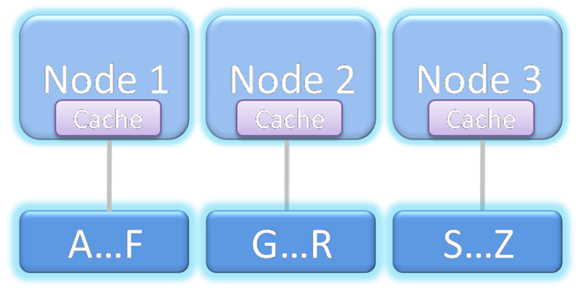
(1) Distribution for Scalability: The Shared Nothing Architecture
Originated in 1990 (Gamma DB) but popularised by Teradata / BigTable /NoSQL
Massive storage potential
Massive scalability of processing
Commodity hardware
Limited by cross partition joins
Autonomous processing unit
for a data subset

Slide 14
(2) Simplifying the Contract
For many users ACID is overkill.
Implementing ACID in a distributed architecture has a significant affect on performance.
NoSQL Movement: CouchDB, MongoDB,10gen, Basho, CouchOne, Cloudant, Cloudera, GoGrid, InfiniteGraph, Membase, Riptano, Scality….

Slide 15

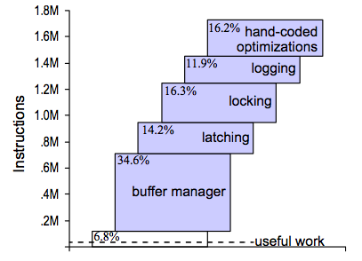
Databases have huge operational overheads
Research with Shore DB indicates only 6.8% of instructions contribute to ‘useful work’
Taken from “OLTP Through the Looking Glass, and What We Found There” Harizopoulos et al

Slide 16
(3) Memory is 100x faster than disk
ms
μs
ns
ps
1MB Disk/Network
1MB Main Memory
0.000,000,000,000
Cross Continental Round Trip
Main Memory
Ref
L1 Cache Ref
Cross Network Round Trip
L2 Cache Ref
* L1 ref is about 2 clock cycles or 0.7ns. This is the time it takes light to travel 20cm

Slide 17
Avoid all that overhead
RAM means:
No IO
Single Threaded
No locking / latching
Rapid aggregation etc
Query plans become less important

Slide 18
We were keen to leverage these three factors in building the ODC
Distribution
Simplify the contract
Memory Only

Slide 19
What is the ODC?
Highly distributed, in memory, normalised data store designed for scalable data access and processing.

Slide 20

The Concept
Originating from Scott Marcar’s concept of a central brain within the bank:
“The copying of data lies at the route of many of the bank’s problems. By supplying a single real-time view that all systems can interface with we remove the need for reconciliation and promote the concept of truly shared services” - Scott Marcar (Head of Risk and Finance Technology)

Slide 21
This is quite tricky problem
High Bandwidth Access to Lots of Data
Scalability to lots of users
Low Latency Access to small amounts of data

Slide 22
ODC Data Grid: Highly Distributed Physical Architecture
In-memory storage
Lots of parallel processing
Oracle
Coherence
Messaging (Topic Based) as a system of record
(persistence)

Slide 23
The Layers
Access Layer
Java client
Java client
API
API
Query Layer
Data Layer
Transactions
Mtms
Cashflows
Persistence Layer

Slide 24
But unlike most caches the ODC is Normalised

Slide 25
Three Tools of Distributed Data Architecture
Indexing
Replication
Partitioning

Slide 26
For speed, replication is best
Wherever you go the data will be there
But your storage is limited by the memory on a node

Slide 27
For scalability, partitioning is best
Keys Aa-Ap
Keys Fs-Fz
Keys Xa-Yd
Scalable storage, bandwidth and processing

Slide 28
Traditional Distributed Caching Approach
Keys Aa-Ap
Keys Fs-Fz
Keys Xa-Yd
Big Denormliased Objects are spread across a distributed cache
Trader
Party
Trade

Slide 29
But we believe a data store needs to be more than this: it needs to be normalised!

Slide 30
So why is that?
Surely denormalisation is going to be faster?

Slide 31
Denormalisation means replicating parts of your object model

Slide 32
…and that means managing consistency over lots of copies

Slide 33
… as parts of the object graph will be copied multiple times
Periphery objects that are denormalised onto core objects will be duplicated multiple times across the data grid.
Trader
Party
Trade
Party A

Slide 34
…and all the duplication means you run out of space really quickly

Slide 35
Spaces issues are exaggerated further when data is versioned
Trader
Version 1
Party
Trade
Trader
Version 2
Party
Trade
Trader
Version 3
Party
Trade
Trader
Version 4
Party
Trade
…and you need versioning to do MVCC

Slide 36
And reconstituting a previous time slice becomes very difficult.
Trade
Party
Trader
Party
Trade
Trader
Party
Trader
Trade
Party

Slide 37
Why Normalisation?
Easy to change data (no distributed locks / transactions)
Better use of memory.
Facilitates Versioning
And MVCC/Bi-temporal
Notes:
This avoids distributed transactions that would be needed when updating dimensions in a denormalised model. It also reduces memory consumption which can become prohibitive in MVCC systems. This then facilitates a storage topology that eradicates cross-machine joins (joins between data sets held on different machines which require that entire key sets are shipped to perform the join operation).

Slide 38
OK, OK, lets normalise our data then. What does that mean?

Slide 39
We decompose our domain model and hold each object separately

Slide 40
This means the object graph will be split across multiple machines.
Trader
Party
Trade
Trade
Trader
Party

Slide 41
Binding them back together involves a “distributed join” => Lots of network hops
Trader
Party
Trade
Trade
Trader
Party

Slide 42

It’s going to be slow…

Slide 43
Whereas the denormalised model the join is already done

Slide 44
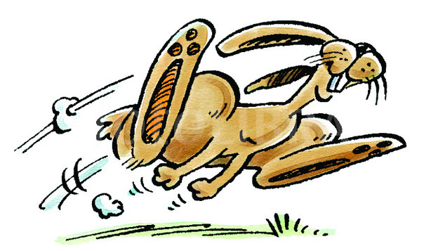
Hence Denormalisation is FAST! (for reads)

Slide 45
So what we want is the advantages of a normalised store at the speed of a denormalised one!
This is what the ODC is all about!

Slide 46
Looking more closely: Why does normalisation mean we have to be spread data around the cluster. Why can’t we hold it all together?

Slide 47
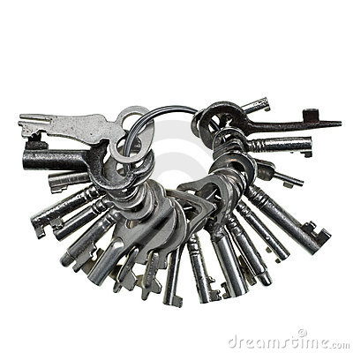
It’s all about the keys

Slide 48
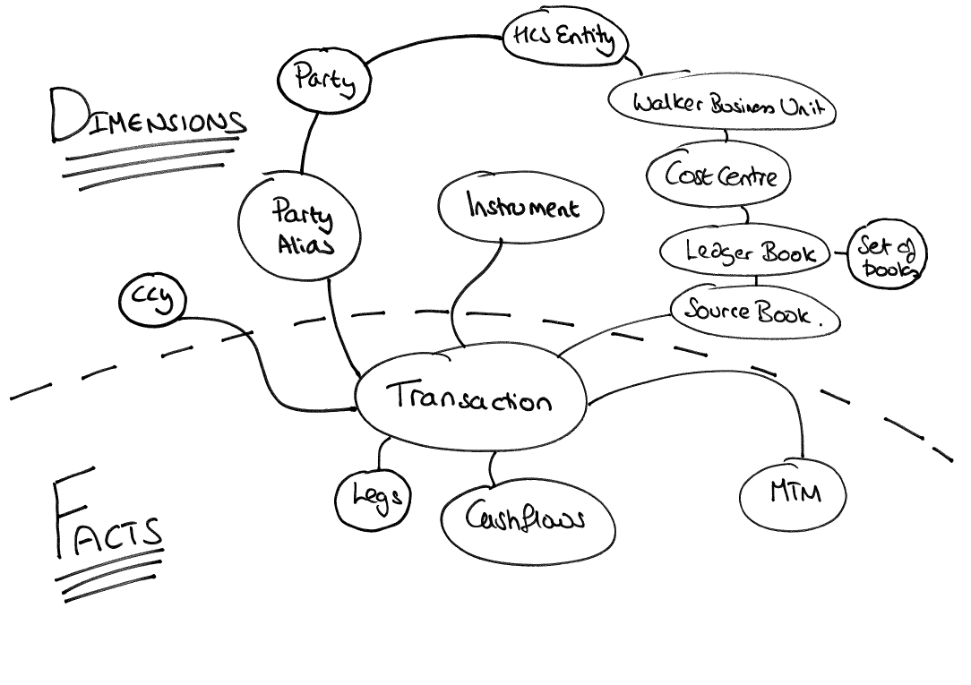
We can collocate data with common keys but if they crosscut the only way to collocate is to replicate
Crosscutting
Keys
Common Keys

Slide 49
We tackle this problem with a hybrid model:
Denormalised
Trader
Party
Trade
Normalised
Notes:
Big data sets are held distributed and only joined on the grid to collocated objects.
Small data sets are held in replicated caches so they can be joined in process (only ‘active’ data is held)

Slide 50

We adapt the concept of a Snowflake Schema.

Slide 51
Taking the concept of Facts and Dimensions

Slide 52
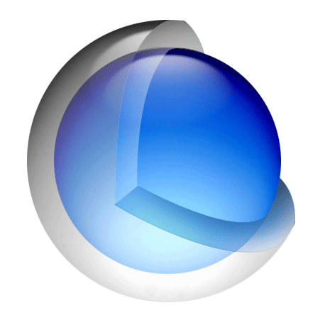
Everything starts from a Core Fact (Trades for us)

Slide 53
Facts are Big, dimensions are small

Slide 54

Facts have one key

Slide 55
Dimensions have many (crosscutting) keys

Slide 56
Looking at the data:
Facts:
=>Big,
common keys
Dimensions
=>Small,
crosscutting
Keys

Slide 57
We remember we are a grid. We should avoid the distributed join.

Slide 58
… so we only want to ‘join’ data that is in the same process
Coherence’s KeyAssociation gives us this
Trades
MTMs
Common Key

Slide 59
So we prescribe different physical storage for Facts and Dimensions
Replicated
Trader
Party
Trade
Partitioned
(Key association ensures joins are in process)
Notes:
Big data sets are held distributed and only joined on the grid to collocated objects.
Small data sets are held in replicated caches so they can be joined in process (only ‘active’ data is held)

Slide 60
Facts are held distributed, Dimensions are replicated
Facts:
=>Big
=>Distribute
Dimensions
=>Small
=> Replicate

Slide 61
- Facts are partitioned across the data layer - Dimensions are replicated across the Query Layer
Query Layer
Trader
Party
Trade
Transactions
Data Layer
Mtms
Cashflows
Fact Storage
(Partitioned)

Slide 62
Key Point
We use a variant on a Snowflake Schema to partition big stuff, that has the same key and replicate small stuff that has crosscutting keys.

Slide 63
So how does they help us to run queries without distributed joins?
Select Transaction, MTM, ReferenceData From MTM, Transaction, Ref Where Cost Centre = ‘CC1’
This query involves:
Joins between Dimensions: to evaluate where clause
Joins between Facts: Transaction joins to MTM
Joins between all facts and dimensions needed to construct return result

Slide 64
Stage 1: Focus on the where clause: Where Cost Centre = ‘CC1’

Slide 65
Stage 1: Get the right keys to query the Facts
Select Transaction, MTM, ReferenceData From MTM, Transaction, Ref Where Cost Centre = ‘CC1’
LBs[]=getLedgerBooksFor(CC1)
SBs[]=getSourceBooksFor(LBs[])
So we have all the bottom level dimensions needed to query facts
Transactions
Mtms
Cashflows
Partitioned Storage

Slide 66
Stage 2: Cluster Join to get Facts
Select Transaction, MTM, ReferenceData From MTM, Transaction, Ref Where Cost Centre = ‘CC1’
LBs[]=getLedgerBooksFor(CC1)
SBs[]=getSourceBooksFor(LBs[])
So we have all the bottom level dimensions needed to query facts
Transactions
Get all Transactions and MTMs (cluster side join) for the passed Source Books
Mtms
Cashflows
Partitioned Storage

Slide 67
Stage 2: Join the facts together efficiently as we know they are collocated

Slide 68
Stage 3: Augment raw Facts with relevant Dimensions
Select Transaction, MTM, ReferenceData From MTM, Transaction, Ref Where Cost Centre = ‘CC1’
Populate raw facts (Transactions) with dimension data before returning to client.
LBs[]=getLedgerBooksFor(CC1)
SBs[]=getSourceBooksFor(LBs[])
So we have all the bottom level dimensions needed to query facts
Transactions
Get all Transactions and MTMs (cluster side join) for the passed Source Books
Mtms
Cashflows
Partitioned Storage

Slide 69
Stage 3: Bind relevant dimensions to the result

Slide 70
Bringing it together:
Replicated Dimensions
Java client
Partitioned
Facts
API
We never have to do a distributed join!

Slide 71
Coherence Voodoo: Joining Distributed Facts across the Cluster
Related Trades and MTMs (Facts) are collocated on the same machine with Key Affinity.
Trades
MTMs
Aggregator
Direct backing map access must be used due to threading issues in Coherence
http://www.benstopford.com/2009/11/20/how-to-perform-efficient-cross-cache-joins-in-coherence/

Slide 72
So we are normalised
And we can join without extra network hops

Slide 73
We get to do this…
Trader
Party
Trade
Trade
Trader
Party

Slide 74
…and this…
Trader
Version 1
Party
Trade
Trader
Version 2
Party
Trade
Trader
Version 3
Party
Trade
Trader
Version 4
Party
Trade

Slide 75
..and this..
Trade
Party
Trader
Party
Trade
Trader
Party
Trader
Trade
Party

Slide 76
…without the problems of this…

Slide 77
…or this..

Slide 78
..all at the speed of this… well almost!

Slide 79


Slide 80

But there is a fly in the ointment…

Slide 81
I lied earlier. These aren’t all Facts.
Facts
This is a dimension
It has a different key to the Facts.
And it’s BIG
Dimensions

Slide 82
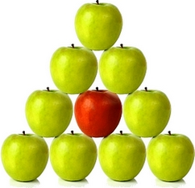
We can’t replicate really big stuff… we’ll run out of space => Big Dimensions are a problem.

Slide 83
Fortunately we found a simple solution!

Slide 84

We noticed that whilst there are lots of these big dimensions, we didn’t actually use a lot of them. They are not all “connected”.

Slide 85
If there are no Trades for Barclays in the data store then a Trade Query will never need the Barclays Counterparty

Slide 86
Looking at the All Dimension Data some are quite large

Slide 87
But Connected Dimension Data is tiny by comparison

Slide 88
So we only replicate ‘Connected’ or ‘Used’ dimensions

Slide 89
As data is written to the data store we keep our ‘Connected Caches’ up to date
Processing Layer
Dimension Caches
(Replicated)
Transactions
Data Layer
As new Facts are added relevant Dimensions that they reference are moved to processing layer caches
Mtms
Cashflows
Fact Storage
(Partitioned)

Slide 90
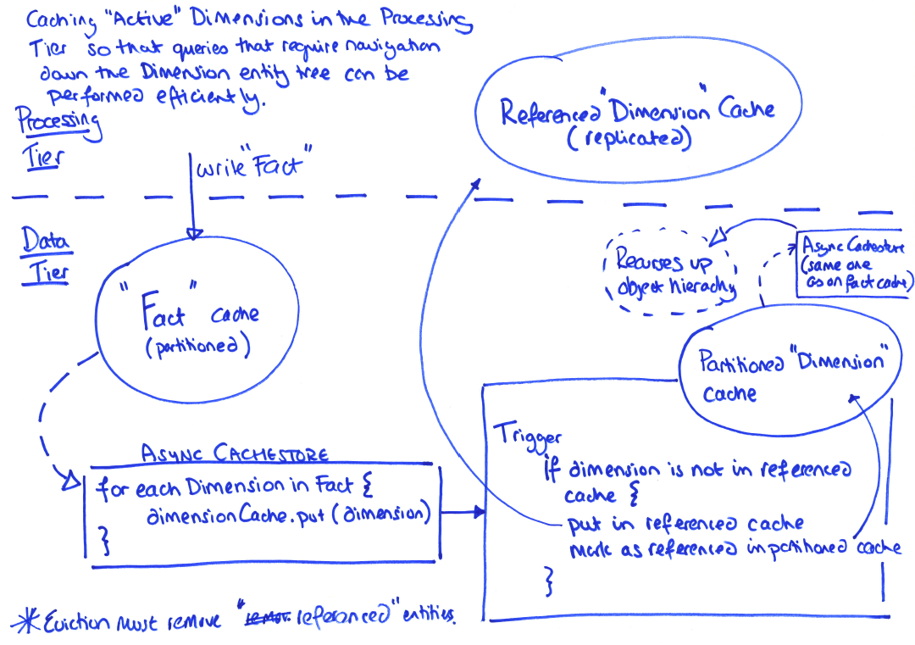
Coherence Voodoo: ‘Connected Replication’

Slide 91
The Replicated Layer is updated by recursing through the arcs on the domain model when facts change

Slide 92
Saving a trade causes all it’s 1st level references to be triggered
Query Layer
(With connected dimension Caches)
Save Trade
Cache Store
Data Layer
(All Normalised)
Trade
Partitioned
Cache
Party Alias
Trigger
Source Book
Ccy

Slide 93
This updates the connected caches
Query Layer
(With connected dimension Caches)
Data Layer
(All Normalised)
Trade
Party Alias
Source Book
Ccy

Slide 94
The process recurses through the object graph
Query Layer
(With connected dimension Caches)
Data Layer
(All Normalised)
Trade
Party Alias
Source Book
Ccy
Party
LedgerBook

Slide 95
‘Connected Replication’
A simple pattern which recurses through the foreign keys in the domain model, ensuring only ‘Connected’ dimensions are replicated

Slide 96
Limitations of this approach
Data set size. Size of connected dimensions limits scalability.
Joins are only supported between “Facts” that can share a partitioning key (But any dimension join can be supported)

Slide 97
Performance is very sensitive to serialisation costs: Avoid with POF
Deserialise just one field from the object stream
Binary Value
Integer ID

Slide 98
Other cool stuff
(very briefly)

Slide 99
Everything is Java
Java client
Java schema
Java ‘Stored Procedures’ and ‘Triggers’
API

Slide 100
Messaging as a System of Record
ODC provides a realtime view over any part of the dataset as messaging is the used as the system of record.
Messaging provides a more scalable system of record than a database would.
Persistence Layer

Slide 101
Being event based changes the programming model.
The system provides both real time and query based views on the data.
The two are linked using versioning
Replication to DR, DB, fact aggregation

Slide 102
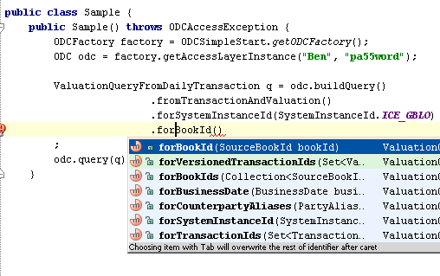
API – Queries utilise a fluent interface

Slide 103
Performance
Query with more than twenty joins conditions:
2GB per min / 250Mb/s
(per client)
3ms latency

Slide 104

Conclusion
Data warehousing, OLTP and Distributed caching fields are all converging on in-memory architectures to get away from disk induced latencies.

Slide 105
Conclusion
Shared nothing architectures are always subject to the distributed join problem if they are to retain a degree of normalisation.

Slide 106
Conclusion
We present a novel mechanism for avoiding the distributed join problem by using a Star Schema to define whether data should be replicated or partitioned.
Partitioned Storage

Slide 107
Conclusion
We make the pattern applicable to ‘real’ data models by only replicating objects that are actually used: the Connected Replication pattern.

Slide 108
The End
Further details online http://www.benstopford.com (linked from my Qcon bio)
A big thanks to the team in both India and the UK who built this thing.
Questions?

